Slide 1
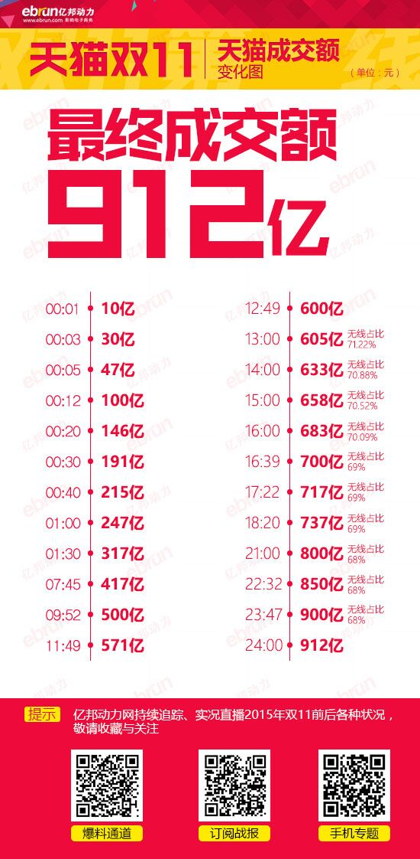
Online Shopping
14英语6班 第三小组
08吴炫燕
09桑佳
10方周婕
11郑磊
12郭晶晶

Slide 2
Part1:line 1-line9
Part2:line 10-line 29
Part3:line 30-line 50
Part4:line 51-line 54

Slide 3
Part 1

Slide 4
Reading&Summary(Erin)
Online shopping has become a vital role in our everyday lives. It surely makes our lives easier but in other hand it also has some disadvantages at the same time.

Slide 5
Clarification(Joyce)
Line 1—virtually: almost or very nearly, so that any slight difference is not important
Line 2—palpable: that is easily noticed by the mind or the senses
Line 3—insurance: an arrangement with a company in which you pay them regular amounts of money and they agree to pay the costs

Slide 6
Question(Edison)
Line6: it undoubtedly bring with it...这句话，为什么用bring with it，that are not available to the personal shopper怎么理解

Slide 7
Translation(Syan)
Line1-Line5:The ever-increasing influence of the Internet on our every ……..They can also purchase more or less any item they might wish to buy.
网络对我们日常生活不断增长的影响，能够在我们实际上做的每一件事上看出来。也许它在电子商务领域上的影响比任何地方都更能感受的到。人们能够在网上购买他们的保险单，建立银行账户，申请信用卡和贷款，预定酒店，度假，车辆和机票。他们还能够或多或少的购买任何想要购买的东西。

Slide 8
Connection(Susie)
Line 1—virtually: Torn apart by war, its economy virtually destroyed, this country now faces a very uncertain future.
Line 2—palpable: The moment I stepped outside the city's vast international airport, I noticed an acrid hint of burning coal in the all-too-palpable air.

Slide 9
Part 2

Slide 10
Reading&Summary(Joyce)
These parts tell us four advantages of online shopping

Slide 11
Clarification(Edison)
Line16— appeal :the power or ability to attract, interest, amuse, or stimulate the mind or emotions .
Line19 —per :for each; for every.
Line23— trawl ：search

Slide 12
Question(Syan)
:Line 25: which allow the purchaser 为什么后面不是跟to have the right ，为什么直接是the right

Slide 13
Translation(Susie)
Line 17—Line23: A second benefit is the range of choice available to ………to be wider than you would find on a trawl of your local stores.
第二个好处是网上购物者有很大的选择范围。通过在线对比引擎，数以百万计的产品都可以作比较，所以已购买的每一样商品都很有可能节约下一比相当可观的钱。网上商品的价格可以那么低的原因是网上开店不需要实体店的运行和管理成本。如果你正在寻找一个特定类型的产品，也许只有专门的店里才有，但是互联网上提供的范围几乎超过你在当地商店的搜索的范围。

Slide 14
Connection(Erin)
(Line14)overwhelming: When facing the 800 meter sports test every semester, most girls would show symptoms of anxiety and overwhelming worry, such as my roommates.
(Line20)bricks-and-mortar: Internet shopping is now so popular that bricks-and-mortar stores should switch strategy to appeal to customers again.

Slide 15
PART 3

Slide 16
Reading&Summary (Edison)
This part mainly introduces four disadvantages of online shopping.

Slide 17
Clarification(Syan)
Line36— invariably: always
lines44—scope: the range of things that a subject, an organization, an activity, etc. deals with
line44—compromise: an agreement made between two people or groups in which each side gives up some of the things they want so that both sides are happy at the end
line46—encryption: the activity of converting from plain text into code
line47—divulge: to give sb information that is supposed to be secret

Slide 18
Question(Susie)
Line32: Although members of public who come within one or other…这句话怎么理解，翻译

Slide 19
Translation(Erin)
Line34 — Line38: When you shop in a real market,……,the camera does occasionally lie
当你在一个真正的市场购物时，你能看到、感觉到甚至试用下想购买的产品。而网购的时候并没有这样的设备存在。你能看到的至多就是感兴趣想买的商品的图片。虽然这总是能准确展示商品，但事实却和俗话相反——相机确实偶尔会说谎。

Slide 20
Connection(Joyce)
Line 44— compromise: Liu Hulan is very strong-willed, she would rather die than compromise her principles to be a traitor.
Line46—encryption: The details of bank accounts are encrypted in order to protect privacy.
Line47—divulge: Edward Snowden was wanted by the American government because he was charged with divulging state secrets.

Slide 21
Part 4

Slide 22
Reading&Summary(Syan)
Online shopping is a double-edged sword.There is inevitably good and bad to be said about both.

Slide 23
Clarification(Susie)
Line 51—avail: to be helpful or useful to sb
Line 52—perceived: something to be noticed or realized
Line 53—embrace: to accept an idea, a proposal, a set of beliefs, etc., especially it is done with enthusiasm
Line 54—inevitably: as is certain to happen

Slide 24
Question(Erin)
No question.

Slide 25
Translation(Joyce)
Line 52-Line53: Ultimately, it is a personal matter for the consumer, whether to embrace the opportunity offered by the Internet of continue with his existing personal shopping practices.
最后，这是消费者的个人事务，是否接受网络所提供的机会或者仍旧坚持个人现存的购物模式。

Slide 26
Connection(Edison)
Line51 — avail oneself of :You would go crazy not to avail yourself of the chance to buy something you’ve always wanted at a low price on double 11.

Slide 27
Thank you!

