Slide 1
Batting Clean-up and Striking Out
14英语6班第三小组
吴炫燕 桑佳 方周婕 郑磊 郭晶晶

Slide 2
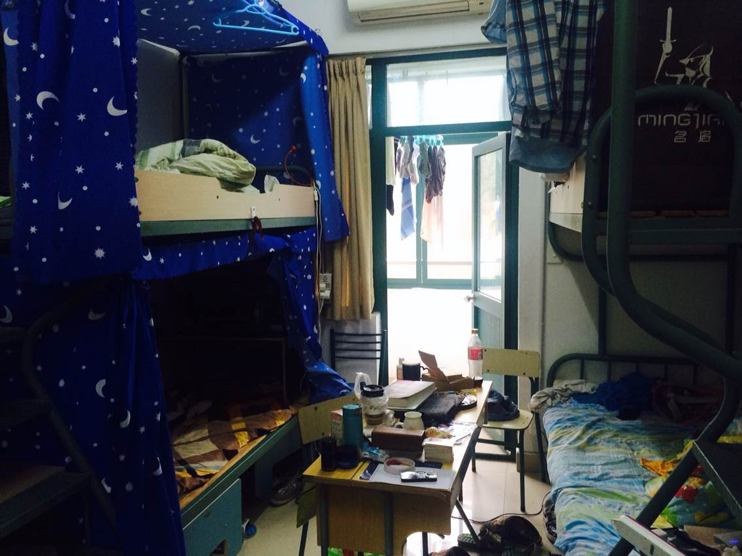
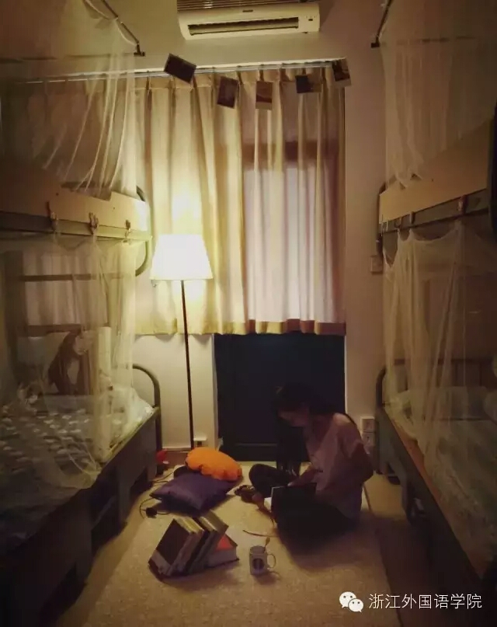
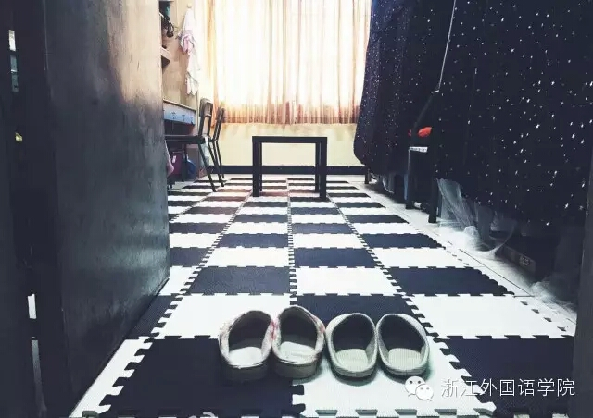
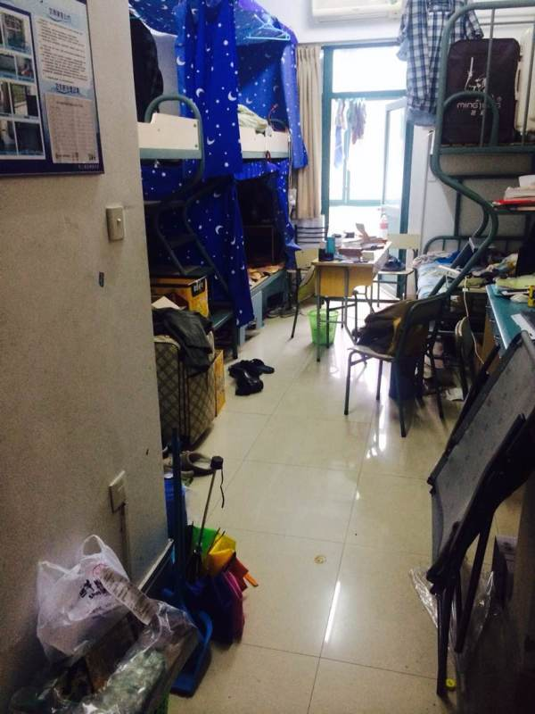
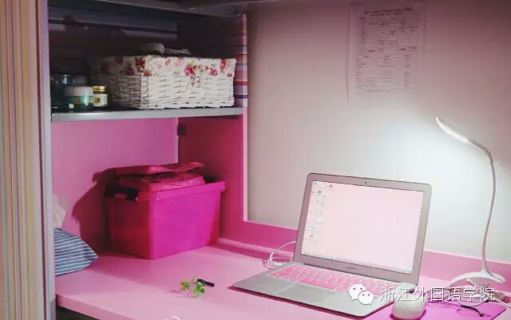
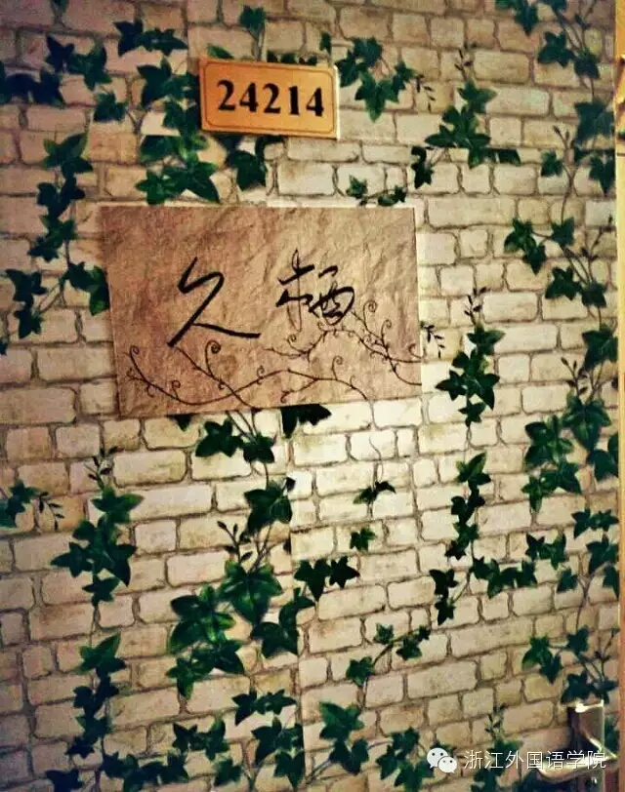
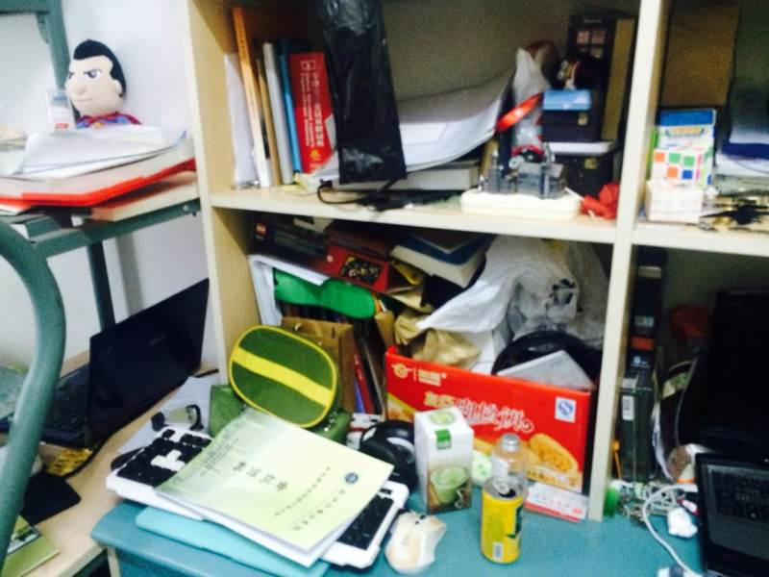
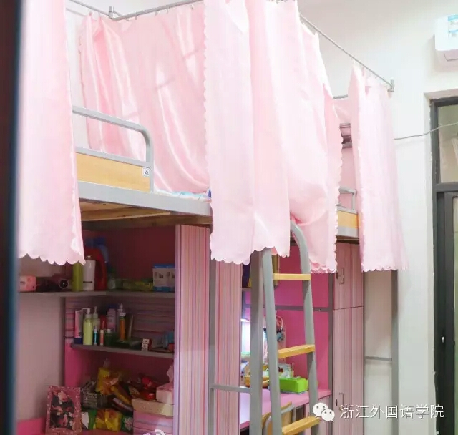
Boys’ dormitory VS Girls’ dormitory

Slide 3
Part 1: line1- line 13
Part 2: line 14- line 28
Part 3: line 29- line 51

Slide 4
Reading & Summary(Erin)
Women can see small quantities of dirt,while men can't. This may lead to tragedy like what had happened in Pompeii.

Slide 5
Question(Joyce)
1.标题“Batting Clean-up and Striking Out”什么意思？
2.(line5) “dirt at the level of molecules” 在本句中用做什么成分？是表强调吗？能不能省略前面的逗号将句子替换成“…that men cannot see and dirt at the level of molecules”?
3.(line5,9) 文章用了很多斜体，例如 “molecules”、“leave”，为什么？
4.(line6)“large enough to support agriculture”怎么理解？
5.(line8)为什么突然说“It’s mighty quiet around here!”

Slide 6
Pun
The pun, also called paronomasia, is a form of word play that suggests two or more meanings, by exploiting multiple meanings of words, or of similar-sounding words, for an intended humorous or rhetorical effect.
Example: Did you hear about the little moron who strained himself while running into the screen door?

Slide 7
Translation（Syan）
line6-line13：This can lead to tragedy…useful housework.
这会导致悲剧，就像在那个不幸的古城庞贝一样，那儿的居民在当地火山爆发时都难逃一死，被20尺厚的火山灰所覆盖。现在的人们经常会问：“这样的事情怎么会发生呢，当火山灰开始落下来的时候，庞贝人难道就不会离开吗？”答案是这样的：庞贝的传统是由男人做家务。他们从来不会注意到灰直到灰已经覆盖住了孩子们的大部分身体。“嘿！”这个男人说道（用拉丁语），“这附近真是太安静了！”这是一个主要的历史原因，解释了为什么男人直到现在也极少能够在做好家务上帮上忙。

Slide 8
Connection(Edison)
Line 2:primary difference
Line 5 :whereas
The primary difference between men and women is that women tend to think men as sloppy, whereas men tend to think their counterparts as neat.

Slide 9
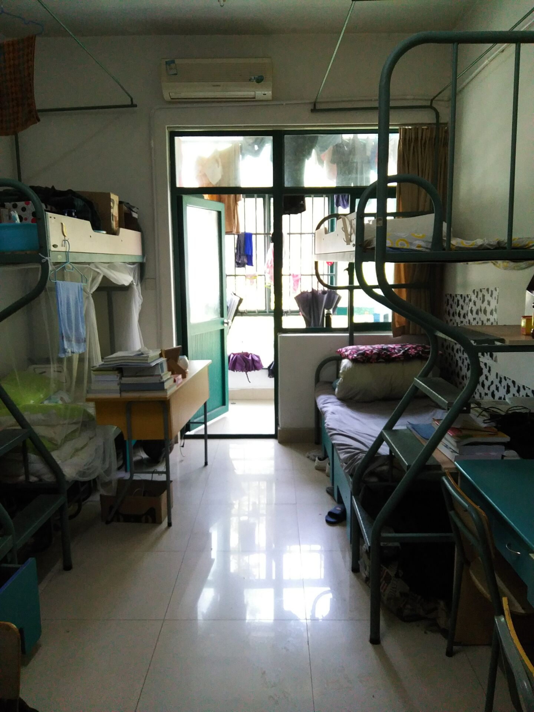
Comments(Susie)
“The primary difference between men and women is that women can see extremely small quantities of dirt.”
I disagree with the author. What enables men or women to see dirt lies not in hormonal secretions, but in personalities of every individual. Some men are just as neat and careful as some women, so that they can also see extremely small dirt ,too.
The primary difference between men and women is the different ways of thinking, not that women can see extremely small quantities of dirt.

Slide 10
Reading & Summary(Joyce)
It happens quite frequently that the author’s wife can see dirt and think the bathroom is filthy even though the author has cleaned it.

Slide 11
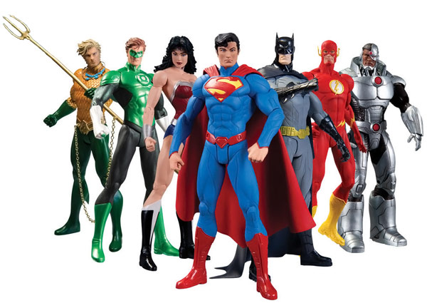
Action figures
It is a kind of game props, sometimes called assembling model. The figures are lifelike in shape and form and players can assemble them according to their own minds.

Slide 12
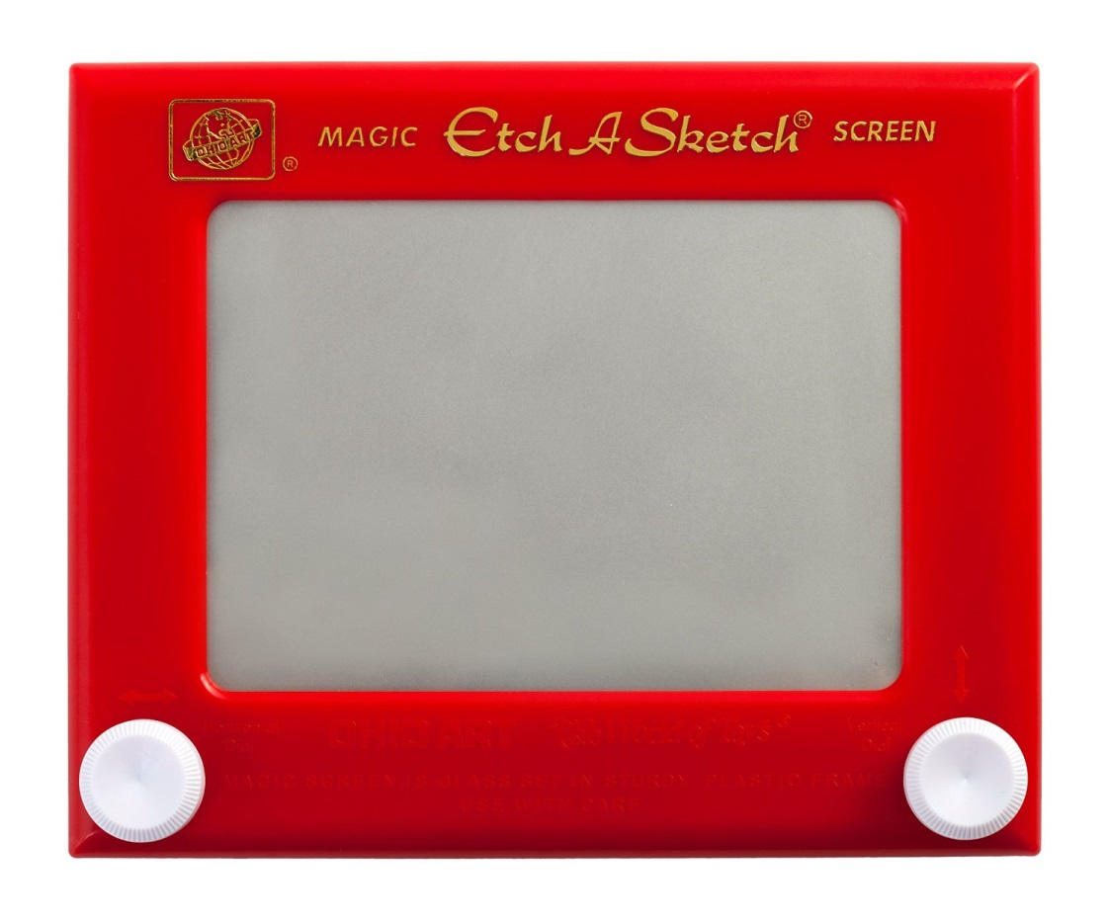
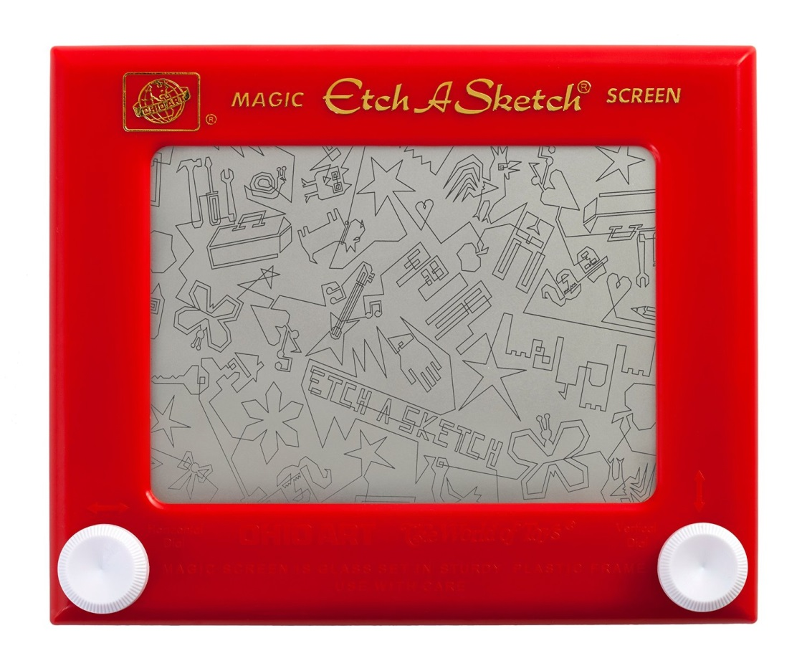
Etch-a-Sketch
It is a software of sketch drawing. To play it, users need to spin the knobs on the left and right in order to control the paintbrush on the drawing board. If you want to make it easier, you can touch the screen with your fingers to get the image. Even more importantly, you can color the picture.

Slide 13
Questions (Susie)
Line 18: “where the men’s room had bacteria you could enter in a rodeo ”怎么理解?
Line 21: “God forbid Robert should ever take a bath without”句子结构是怎么样的？翻译成“Robert 洗澡时一定要有…”对吗？
Line 22：“wipe it back off”back在这里什么意思，可以省略吗?

Slide 14
Translation(Erin)
Line 25-Line 28: She is in there looking at the very walls I just Windexed……pajamas.
她站在那里看着我恰好清理过的墙面，她居然看到了污垢，到处的污垢！要是我告诉她我已经清理过浴室了，（她会摆出那个她很擅长的表情？），就和上次我为Robert挑选上学服装，但把部分衣服挑成了睡衣时候的她的表情一样。

Slide 15
Connection（Syan）
line15：filthy
Once I saw a dwarf beggar who wore filthy old clothes in the street. Suddenly he clasped one passerby’s leg to ask for money, and he didn’t let the passerby go until he got the money. It very award for the passerby so the beggar got money successfully every time. But I think the bagger just like a robber.

Slide 16
Comments(Edison)
By depicting a family anecdote, the author contrasts woman and men in a very jokingly matter, conveying his purpose that there are so many differences between both men and woman and it makes life interesting and fun.

Slide 17
Reading&Summary(Edison)
By depicting a hilarious scene, the author claims that men tend to be more sensitive to sports than women.

Slide 18
Question（Syan）
line35:over to her house for an evening of stimulating conversation…
--怎么理解“over”？
line37：If you can imagine such a social gaffe.
--怎么理解“social gaffe”
line48：And just like that he was off to the family room, moving quickly for a big man holding a baby.
--“that”指的是？

Slide 19
Translation(Susie)
Line 38-line 41：“We sat around….as though nothing were wrong.”
我们坐在客厅里，Maddy尝试着挑起一个话题。但是我们男士并不能将我们的注意力集中到Maddy提出的各种各样的话题中。因为我们所真正感觉到的是电视和广播播放的世界职业棒球大赛的热闹场景，那些射线穿过空气发出尖叫声，刺激着我们的兴奋细胞，引起我们牙齿抑制不住的震动，而女人们却一直表现得像一切正常一样。

Slide 20
Connection(Joyce)
representative (line 34)
gaffe (line 37)
pivotal (line 51)
With the existence of the cultural differences, the same gesture may have different meanings in different countries, and if people don’t use it properly, it’ll turn out to be a gaffe. The representative gesture of praise is “thumbs-up” in many countries, but it is forbidden to be used in Iran because it means shut up or go away. To avoid this from happening, the pivotal way is to know the culture of that country before you go there and “When in Rome, do as the Romans do.”

Slide 21

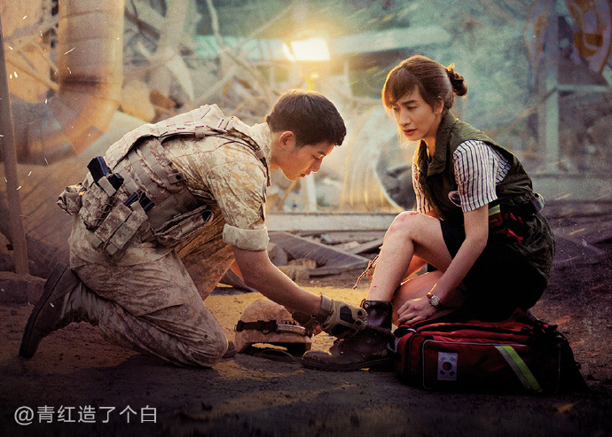
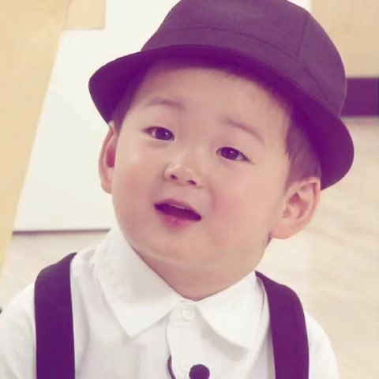




Comments (Erin)
Line 29-Line 30: The opposite side of the dirt coin, of course, is sports. This is an area where men tend to feel very sensitive and women tend to be extremely callous.
I quite agree with the author.
For most girls, or women, they may be interested in international sports like World Cup, the Olympic Games. But to be honest, they don't care for it, they watch it just to show they are not out of date and participating it.

Slide 22
Thank you!

