Slide 1
Air Pollution
16英语6班 丁悦 蒋妃 罗梦圆 胡家钰 来楠楠

Slide 2
CONTENTS
1
3
Questionnaire
Feelings
2
4
Analysis
Suggestion

Slide 3
Questionnaire
From the investigation we can see that many people do not understand the World Environment Day.

Slide 4
Questionnaire

Slide 5
Questionnaire
The government's propagandas on environmental protection are not enough.
The legal system of environmental protection is not perfect.
School education is not enough.

Slide 6
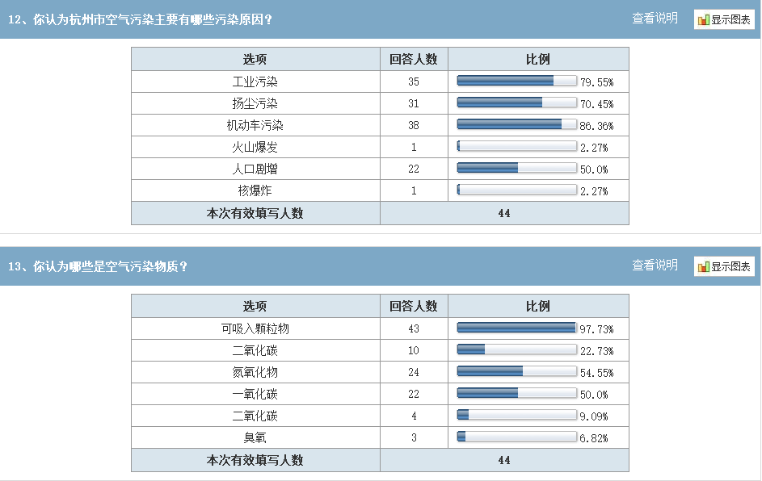
Questionnaire

Slide 7
Analysis
Source of Atmospheric Pollution
Source of atmospheric pollution can be divided into two categories: natural and man-made. Natural pollution sources are caused by natural causes (such as volcanic eruptions, forest fires, etc.), which are caused by people's production and living activities. In the man-made pollution source, it can be divided into fixed (such as chimney and industrial exhaust) and mobile (such as car, train, plane, ship) two. Due to the common and frequent existence of man-made pollution sources, people pay more attention to it than natural pollution sources.

Slide 8
Feelings
Towards the public：
People begin to care more about the quality of their living environment. (air pollution has already been the focus of people’s attention. )
However, based on our questionnaires, most people only focus on the results rather than the process.
people only occasionally pay attention to the air problem when listening to the weather broadcast.
many people refuse to take the public transportation or walk on foot, and they just drive cars a lot which produces a large amount of harmful gases.
All in all, I think we should transfer thoughts into practical actions rather than just care about the results.

Slide 9
Feelings
Towards the government：
Economic progress has provided sufficient funds for the government to do something about the pollution.
A lot of related laws and regulations have been worked out and some governance projects have also been established.
But people think, it’s not enough. Air pollution requires greater attention and governance.

Slide 10
Feelings
Towards myself：
The serious problem of air pollution has become an undeniable fact. In Hangzhou, we will also suffer from smoggy days very often, especially in winter and early spring. As we all know, Hangzhou is now in a period of rapid development. Industry also holds a large proportion in the economy. So air pollution is unavoidable in some degree.
Pollution is not terrible, what is terrible is that we do not care about it. Generally speaking, our condition is not that bad because our attitude towards air pollution is determined and we also put forward a lot of measures to cope with it. From where I stand, I think everyone should take responsibility to better our environment, not only our government. Only when we public as well as our government all be together and take actions, we will improve our surroundings better.

Slide 11
Suggestions
Air pollution is closely related to us, so it cannot be ignored.
What can we do to protect it?
To the government:
Making laws is important, but what’s more important is to carry them out.
Strengthen the supervision of polluting factories, make it sure that every factory is equipped with wastes treatment devices.
Sound the public transport system, reduce the number of cars.
Increase technological efforts to explore new energy.
(Make full use of wind energy solar tidal energy; reduce the use of coal and petroleum.)
Strengthen social propaganda and ideological education, raise people’s awareness of environmental protection.
Countries work together to control pollution.

Slide 12
Suggestions
To the public and ourselves:
Choose a green life style, drive less.
Refuse to litter around. Try to do garbage classification as possible as you can.
If it’s possible, use air condition less in order to protect our Ozone layer.
Use relatively pure fuel to reduce pollution.
Filter the emitted contaminant gas.
Make full use of wind energy solar tidal energy; reduce the use of coal and petroleum.

Slide 13
THANKS

